Slide 1
Youth Risky Behavior

Slide 2

Slogan: Stay strong, Say No To Drugs: FOCUS ON YOUR FUTURE!

Slide 3


Traditional and cyber bullying:

Slide 4


Substance Abuse:

Slide 5

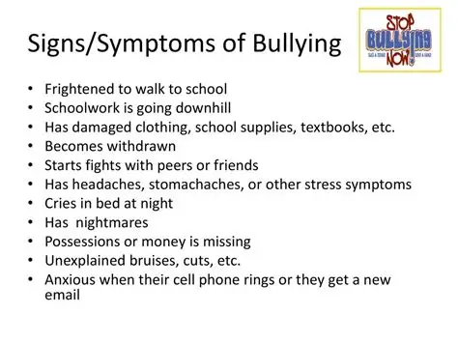
Signs and symptoms

Slide 6


Slide 7


